Slide 1
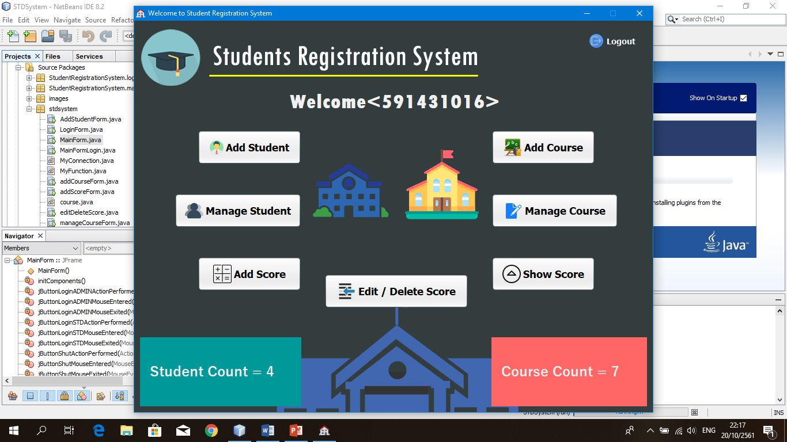
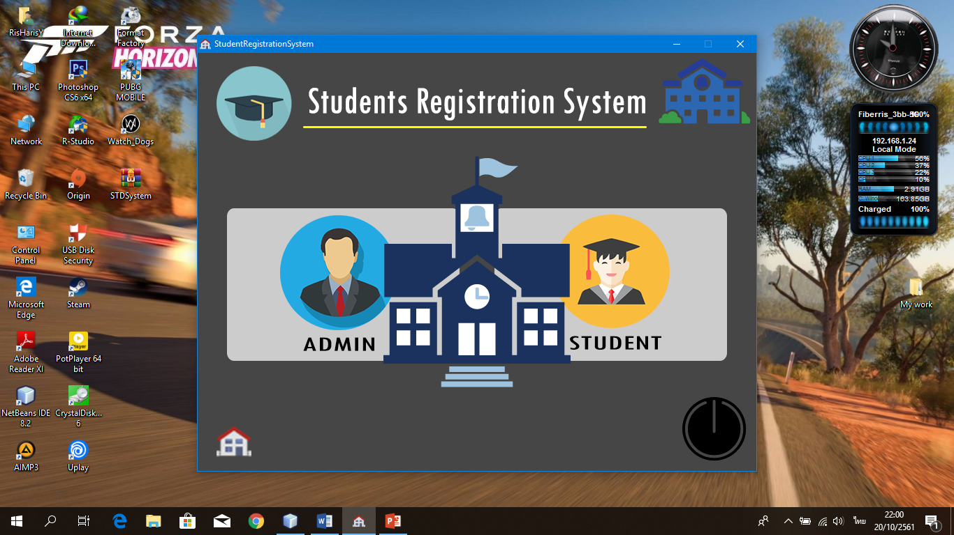
Student Registration System
Group Name : STDR System
Group Member : Amdulharis Yunuh 591431016
MuhammadAtip Waehama 591431008

Slide 2
The Main Form
Shutdown

Slide 3
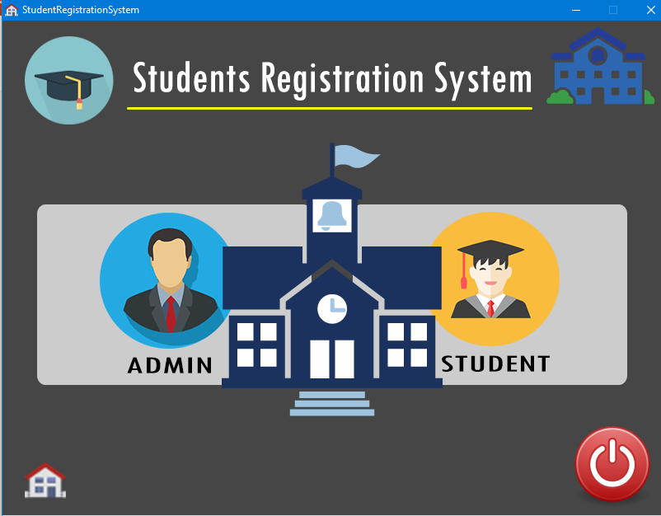
The Main Form
When we click

Slide 4
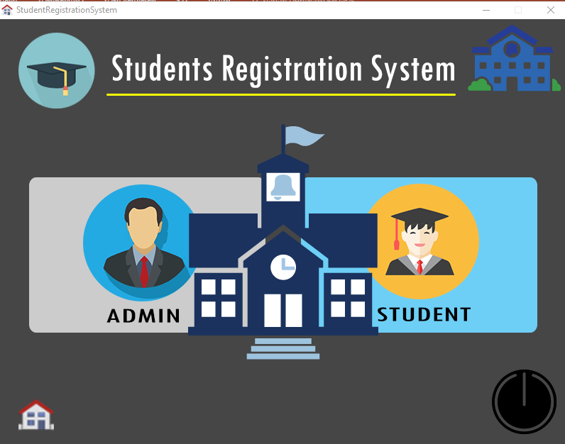
The Main Form
If choose STUDENT
Or click.

Slide 5
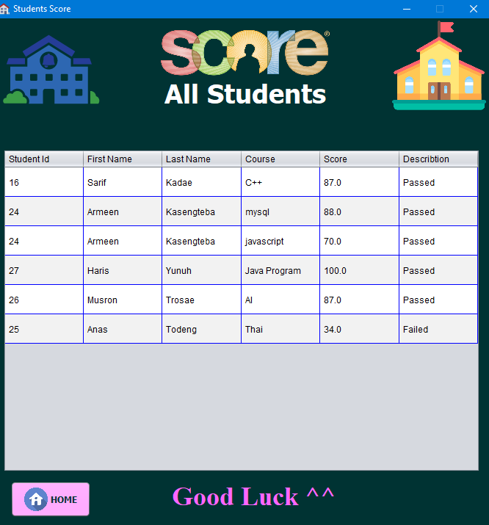
Student From
Just show only table all student

Slide 6
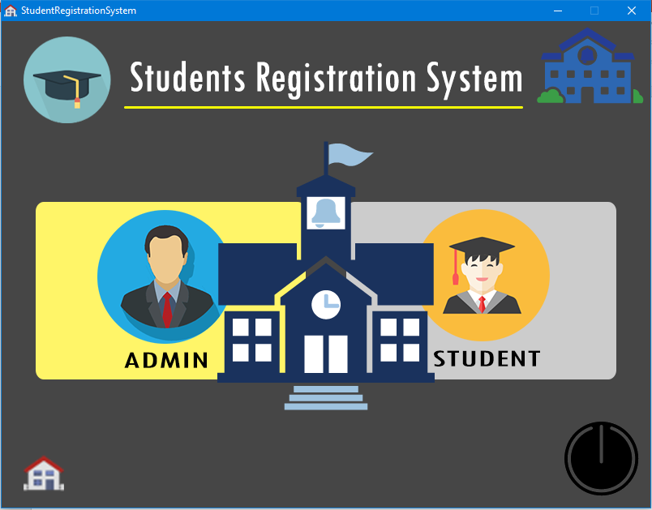
The Main Form
If choose ADMIN
Or click.

Slide 7
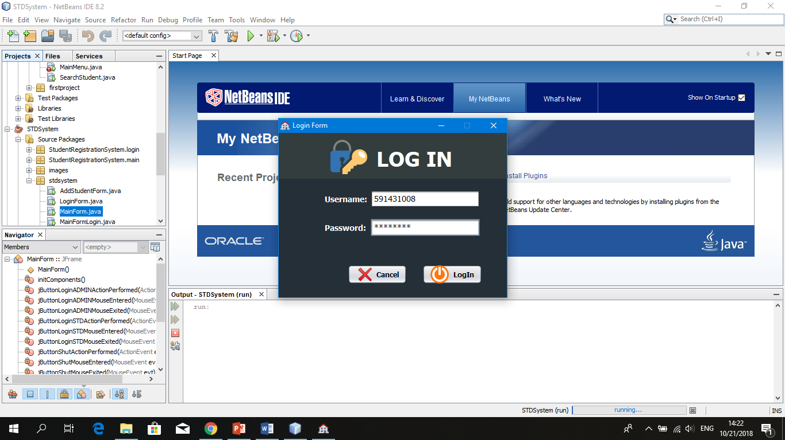
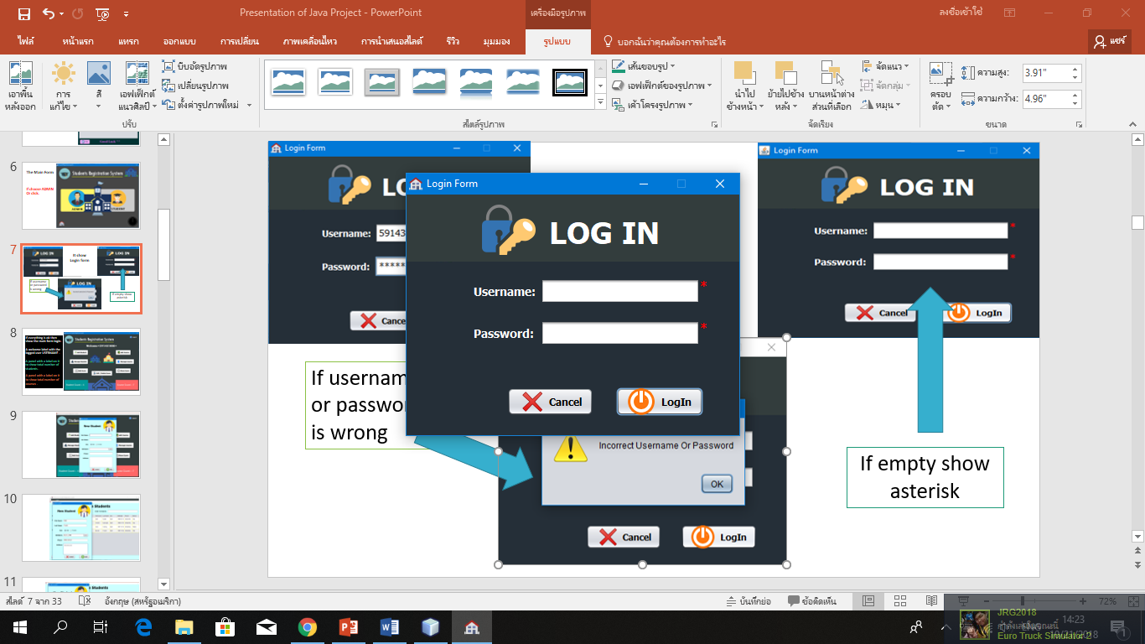
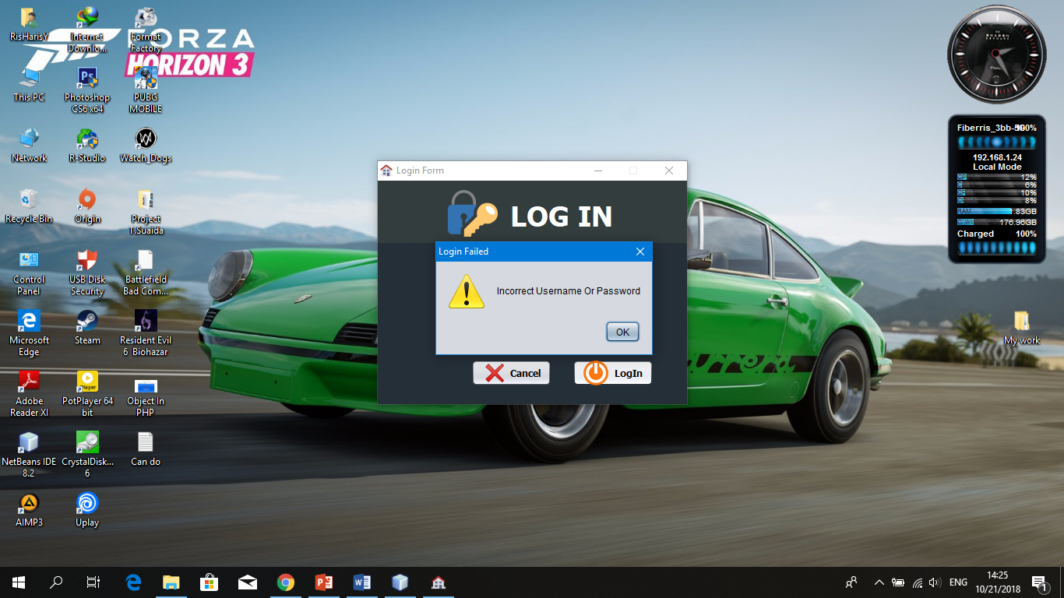
It show
Login form
If username or password is wrong
If empty show asterisk

Slide 8
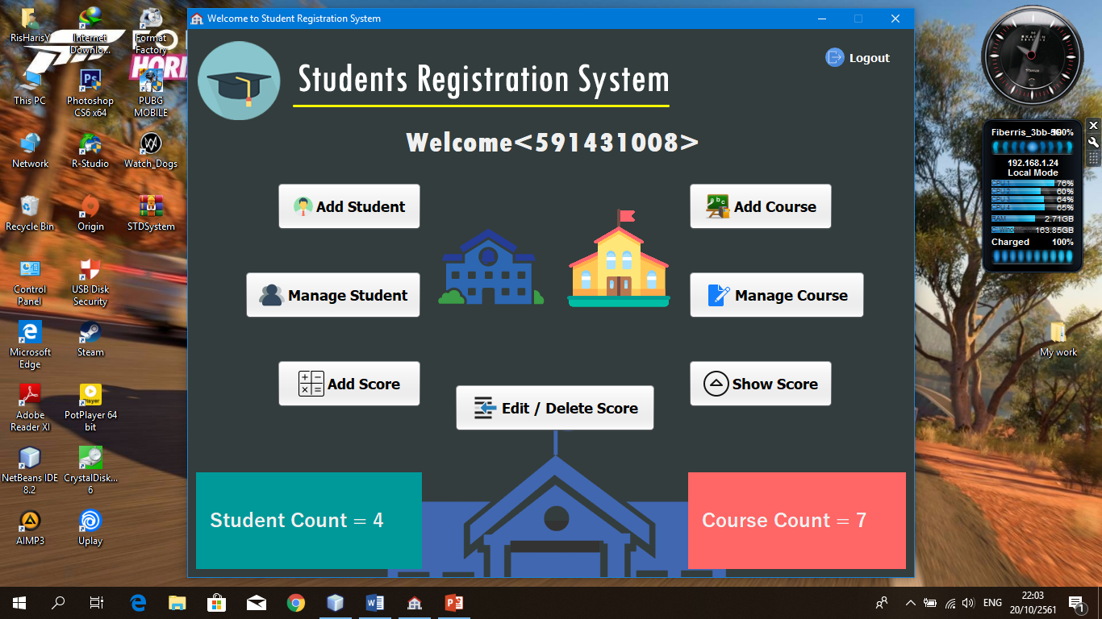
If everything is ok then show the main form login.
A welcome label with the logged user USERNAME .
A panel with a label on it to show total number of students .
A panel with a label on it to show total number of courses .

Slide 9
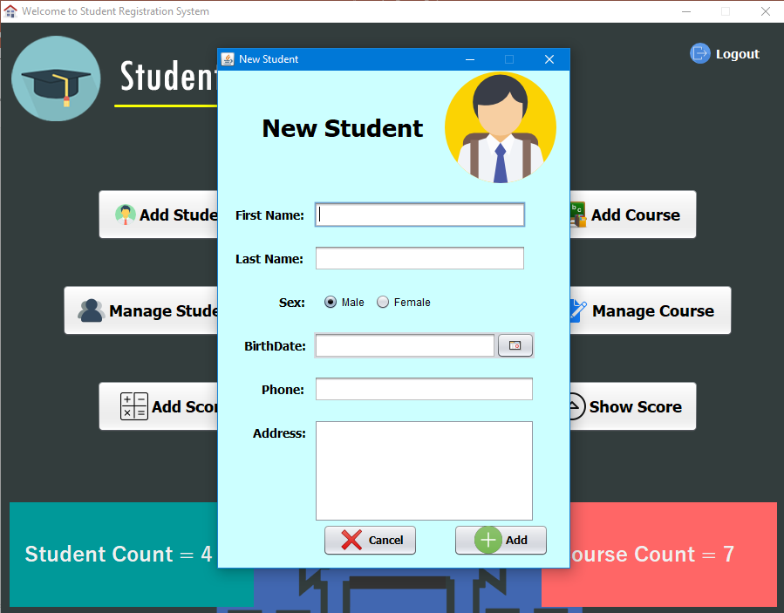
Add new student
User can add new student.
Depend on user.

Slide 10
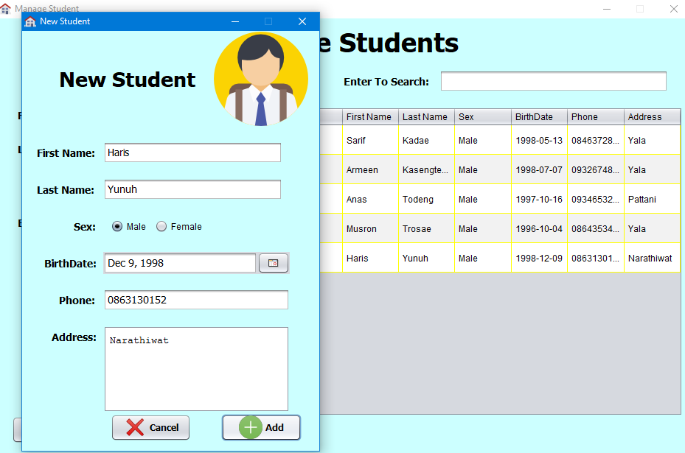
It will show on table now

Slide 11
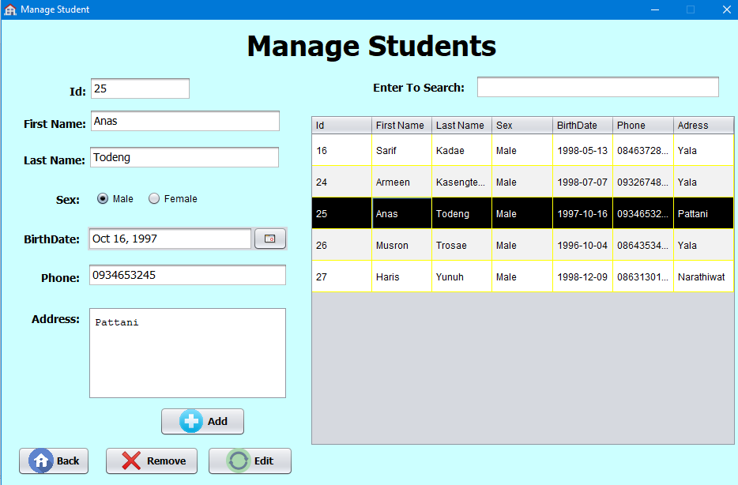
Manage student
User can add new student, edit student, delete or remove student we call user can control everything.

Slide 12
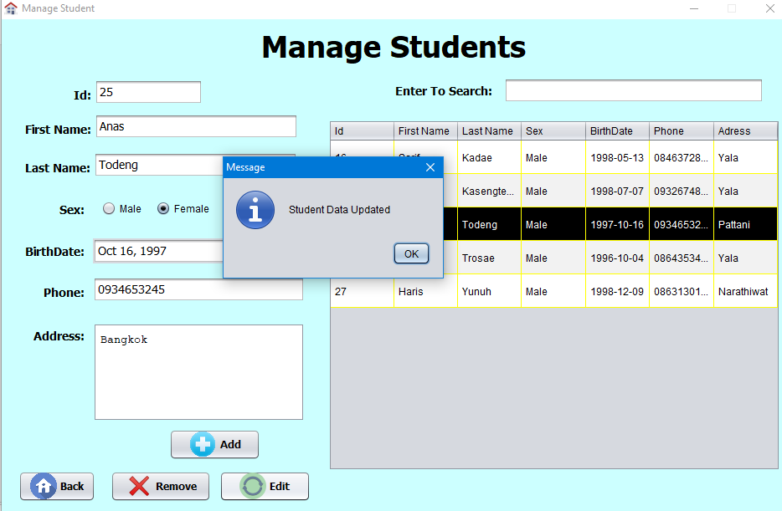

Slide 13
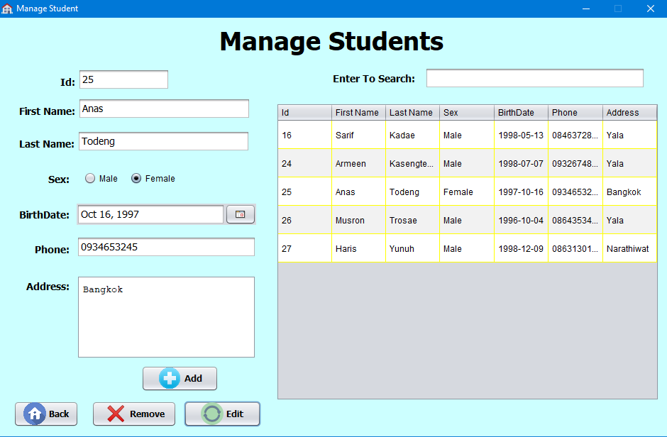
It will show on table now

Slide 14
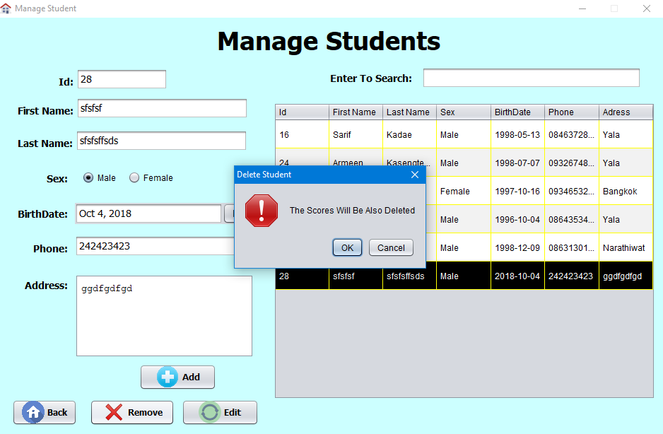
If we delete
It will show
Massage

Slide 15
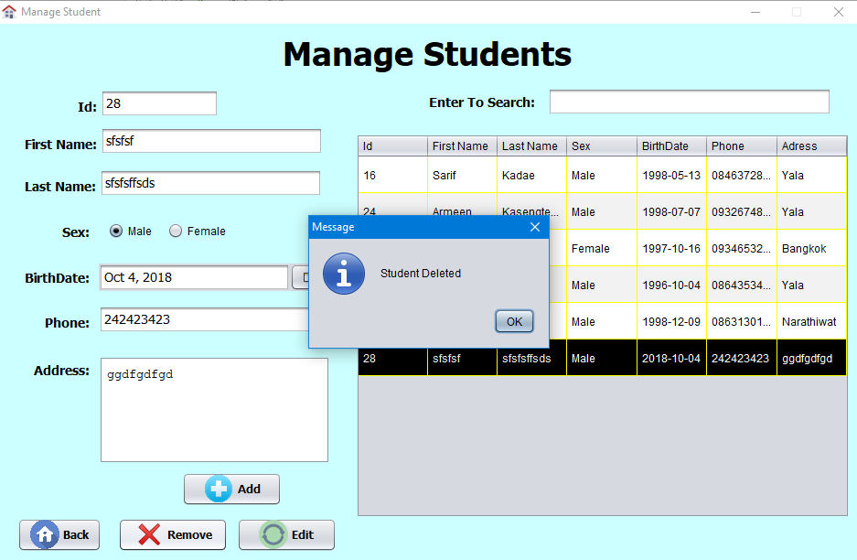
If click ok that mean deleted

Slide 16
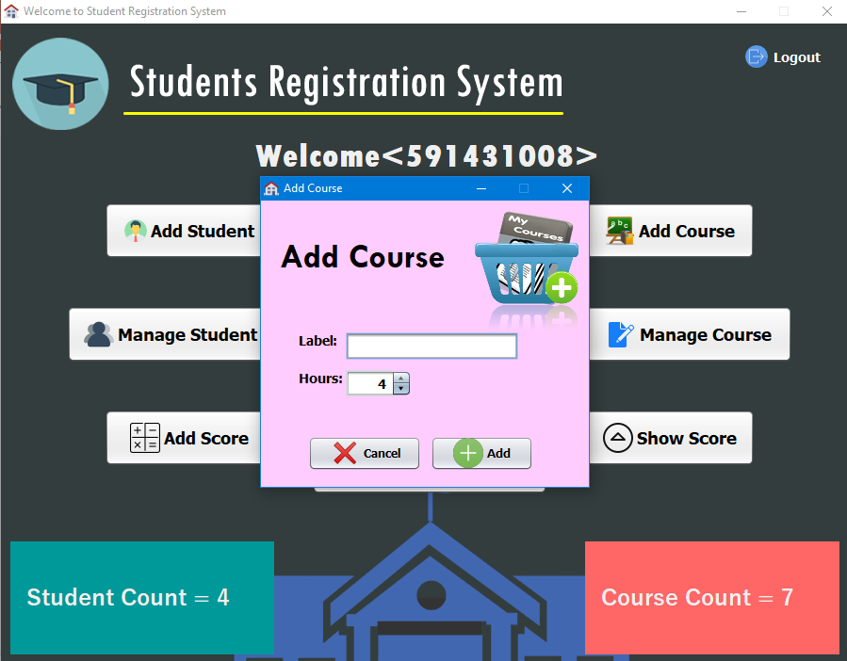
Add Course
User can add new course.
Depend on user.

Slide 17
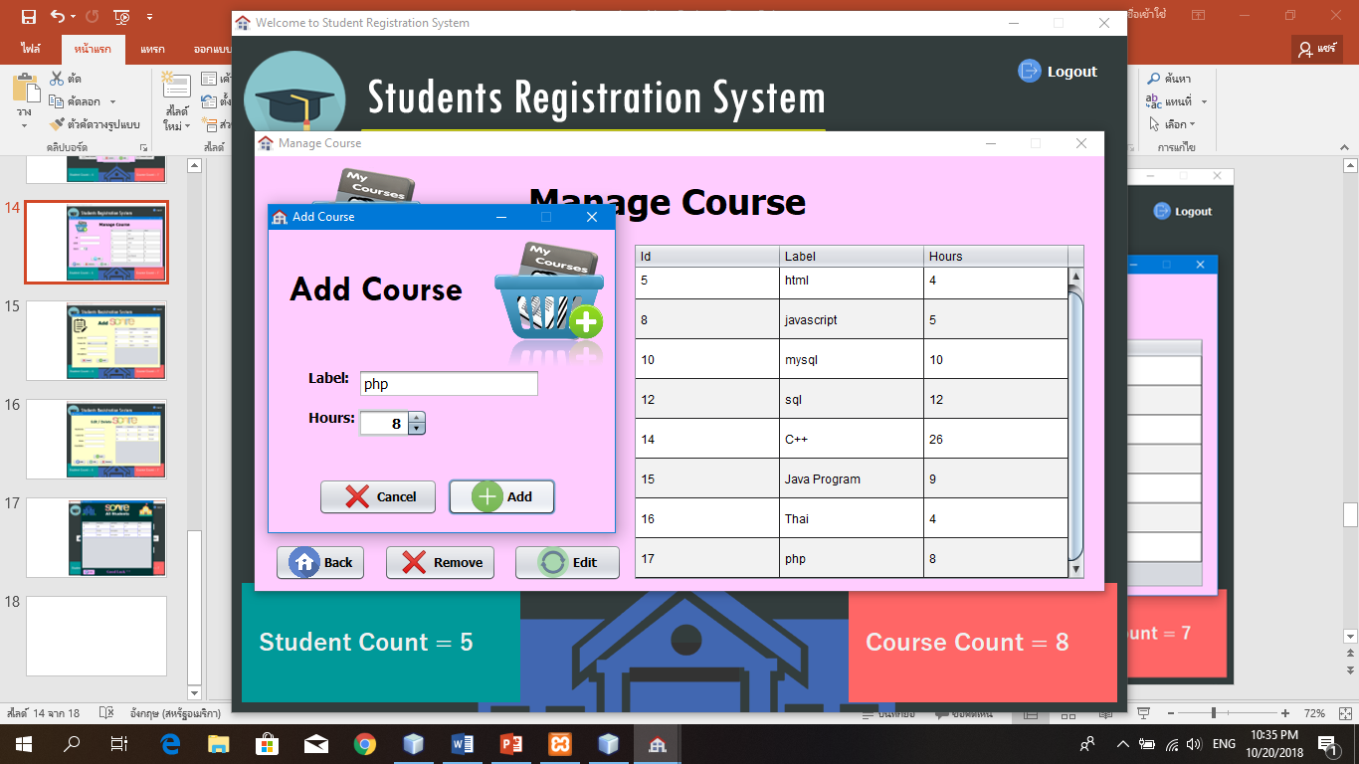
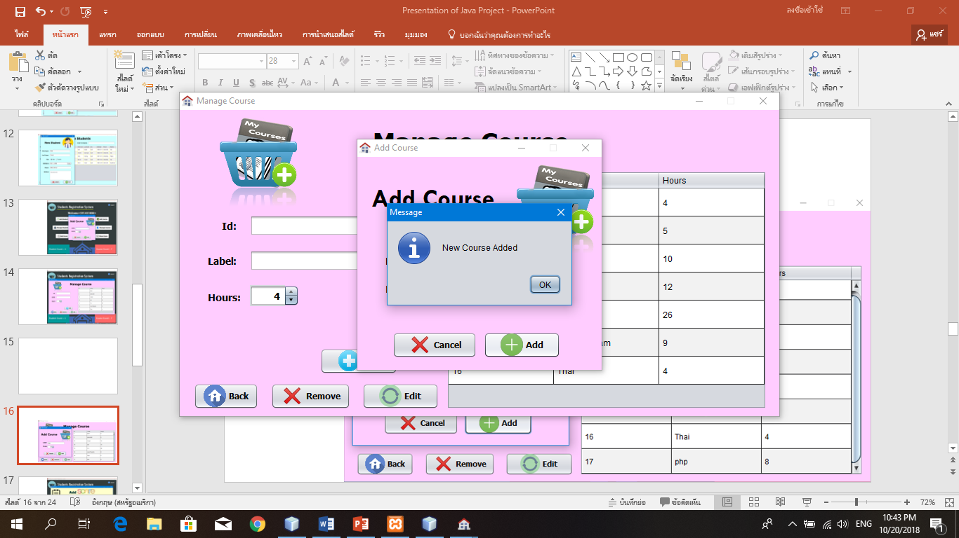

Slide 18
It will show on table now

Slide 19
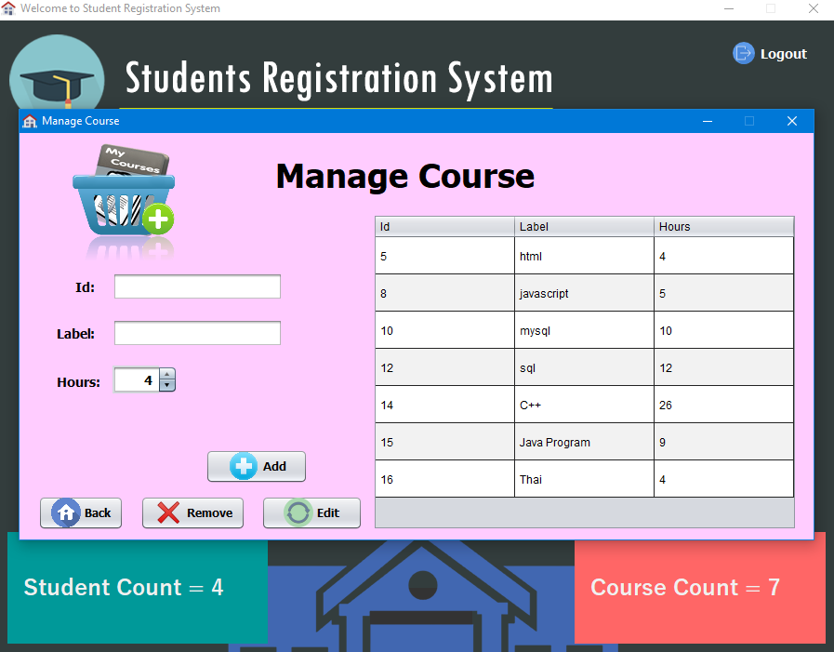
Manage course
User can add new course, edit course, delete or remove course we call user can control everything.

Slide 20
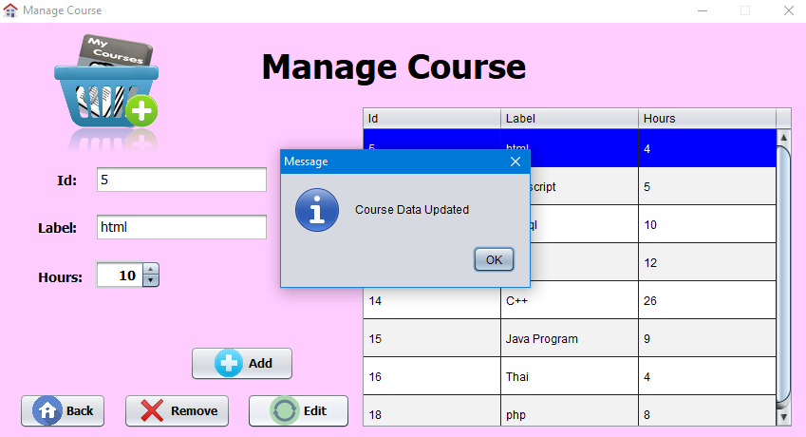

Slide 21
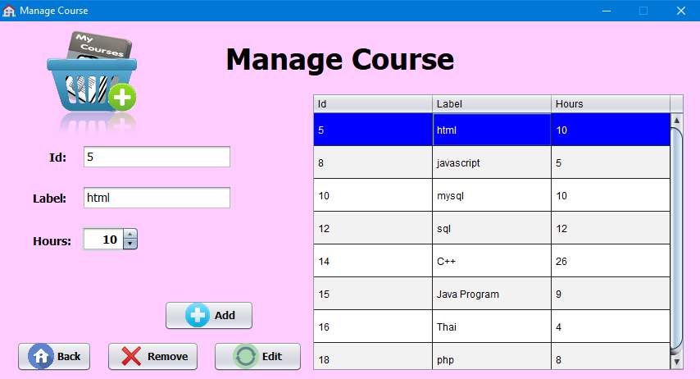
It will show on table now

Slide 22
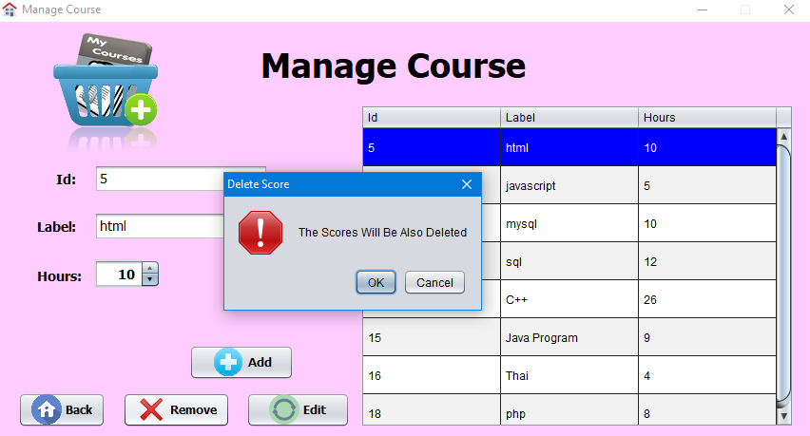
If we delete
It will show
Massage

Slide 23
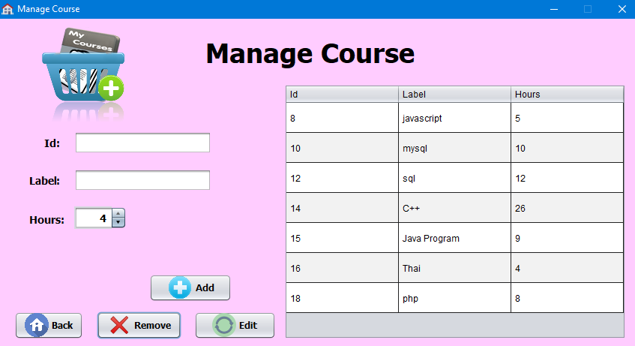
If click ok that mean deleted

Slide 24
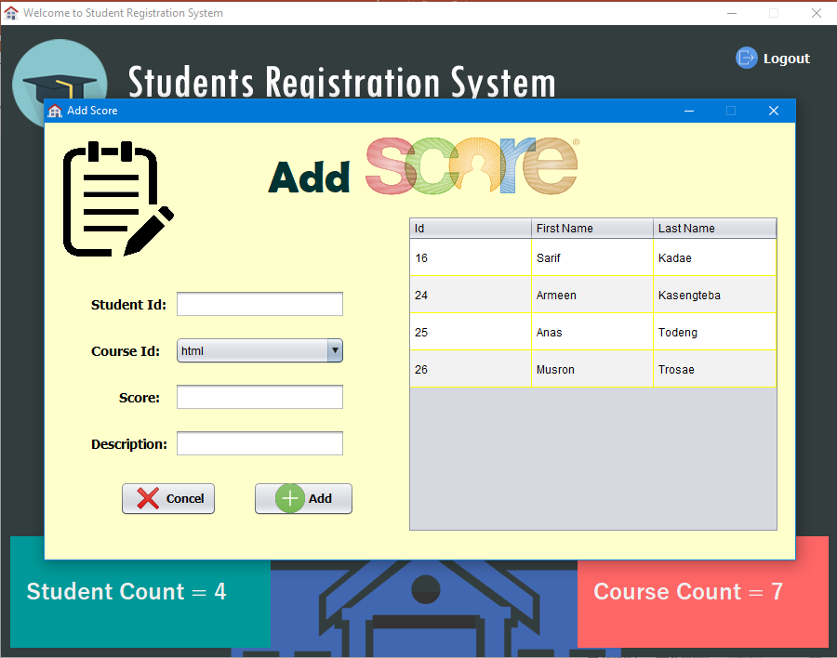
Add score
User can add score to each student,
edit score, delete or remove score depend on user.

Slide 25
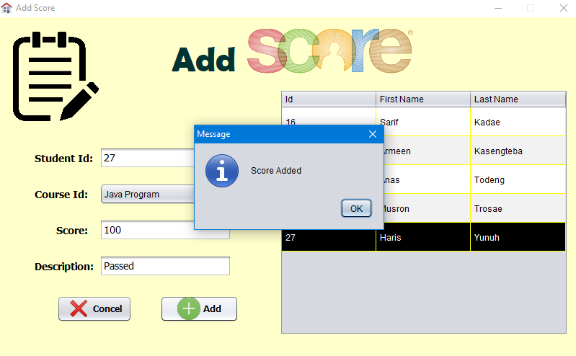

Slide 26
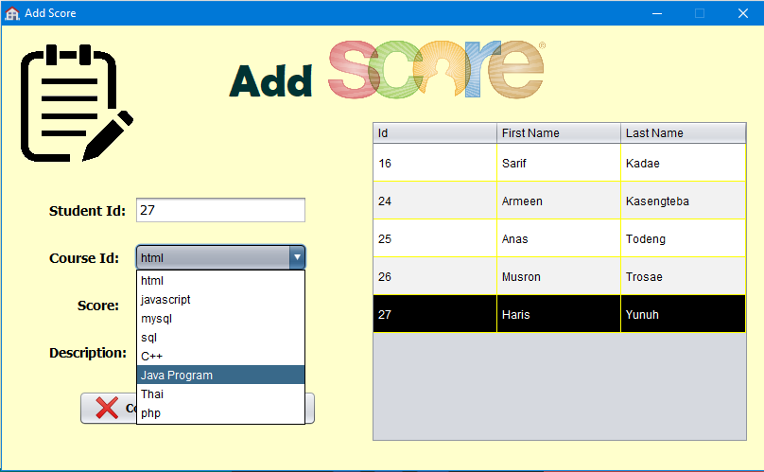
Course id can select depend on user.

Slide 27
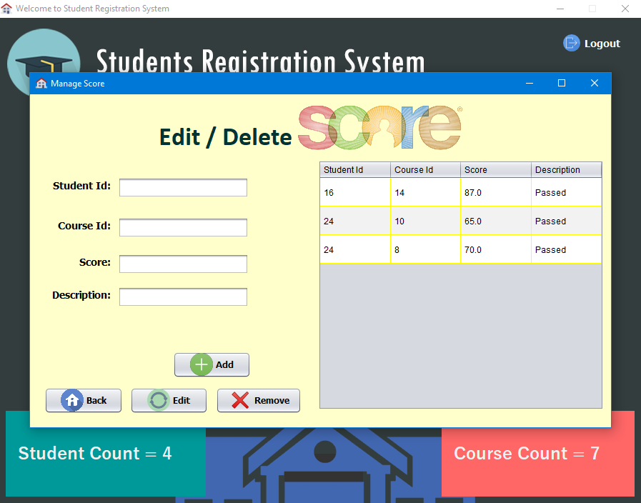
Edit / Delete Score
This is user can edit or update score or
if no need some score
it can delete by user.

Slide 28
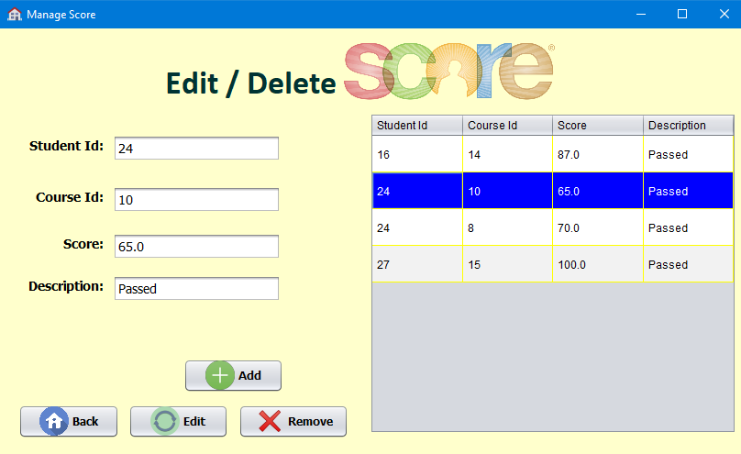
Edit or update score

Slide 29
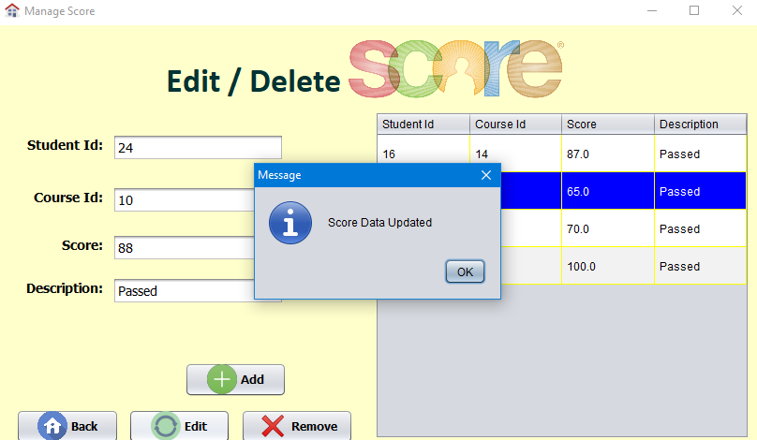
Edit or update score already

Slide 30
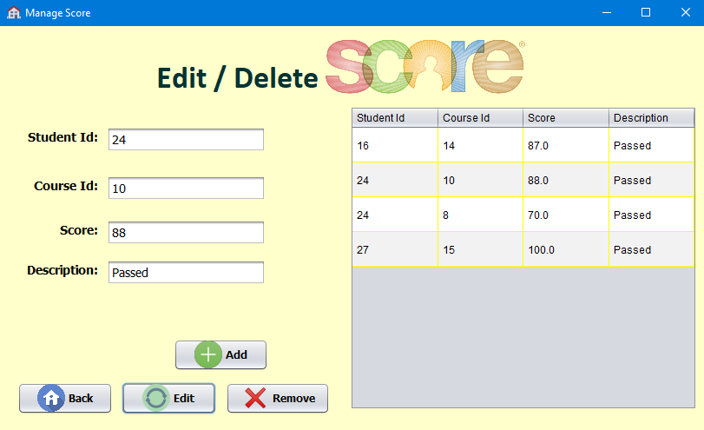
It will show on table now

Slide 31
If we want to know all student score
Click here

Slide 32
This is will show on table all student now

Slide 33
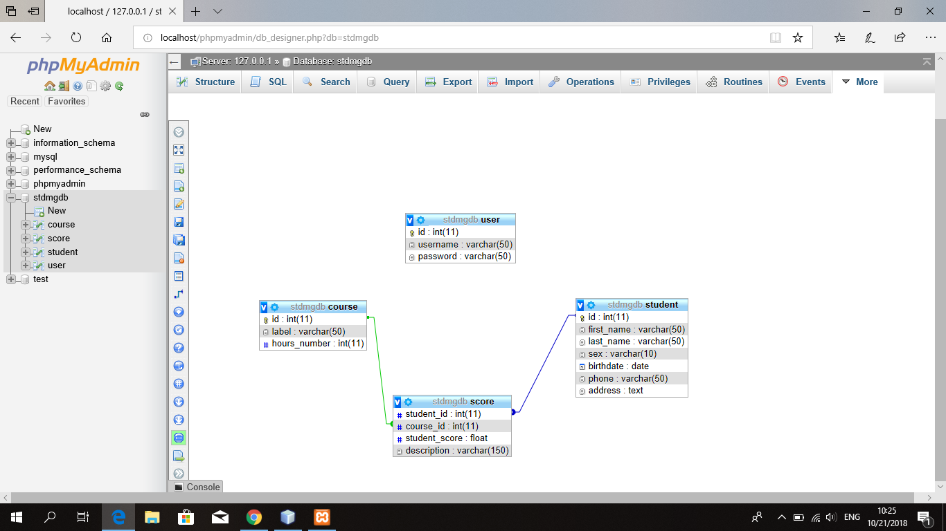
DATABASE Of STDR System in XAMPP

Slide 34
Thank You

